Slide 1

Dynamics in brain networks: application to epilepsy
Marinho Lopes Luke Tait, Alex Shaw, Dominik Krzemiński Brain Modelling Workshop, CUBRIC, June 15, 2020

Slide 2
Epilepsy
What is epilepsy?
Epilepsy is a brain disorder characterized by recurrent and unpredictable seizures.
What is a seizure?
A seizure is a “a transient occurrence of signs and/or symptoms due to abnormal excessive or synchronous neuronal activity in the brain.”
Fisher, Robert S., et al. "Epileptic seizures and epilepsy: definitions proposed by the International League Against Epilepsy (ILAE) and the International Bureau for Epilepsy (IBE)." Epilepsia 46.4 (2005): 470-472.

Slide 3
Epilepsy – the role of EEG
The electroencephalogram (EEG) plays a central role in the diagnosis of epilepsy.
EEG of a healthy individual at rest (eyes closed):
https://projects.exeter.ac.uk/time/methods.php?cat=eeg

Slide 4
Epilepsy – the role of EEG
The electroencephalogram (EEG) plays a central role in the diagnosis of epilepsy.
EEG of an (absence) epileptic seizure:
https://projects.exeter.ac.uk/time/methods.php?cat=eeg

Slide 5
Some key questions about epilepsy
What makes a brain susceptible to generate seizures?
What mechanisms underlie the transition from “normal” brain activity to seizures?
Network neuroscience has shown that people with epilepsy have abnormal brain networks.
To move from correlation to causality we need to understand why such abnormalities “imply” epilepsy.
Richardson, Mark P. "Large scale brain models of epilepsy: dynamics meets connectomics." Journal of Neurology, Neurosurgery & Psychiatry 83.12 (2012): 1238-1248.

Slide 6
Modelling epilepsy
Mathematical modelling of brain activity may help us answer these questions.
What models shall we use?
Microscale or macroscale models?
Biophysical or phenomenological models?
It depends on the question and on the current knowledge.

Slide 7
Possible models - microscale
I&F:
Morris-Lecar:
Izhikevich, Eugene M. "Which model to use for cortical spiking neurons?." IEEE transactions on neural networks 15.5 (2004): 1063-1070.

Slide 8
Possible models - macroscale
Neuronal network models (meso/macroscale)
e.g. Izhikevich and Edelman (2008) – 1 million neurons, ~half billion synapses
Neural mass models (and networks of neural mass models)
e.g. Wilson-Cowan model; Jansen-Rit model; Wendling model; …
More on this: Breakspear, Michael. "Dynamic models of large-scale brain activity." Nature neuroscience 20.3 (2017): 340.
Izhikevich, Eugene M., and Gerald M. Edelman. "Large-scale model of mammalian thalamocortical systems." Proceedings of the national academy of sciences 105.9 (2008): 3593-3598.

Slide 9
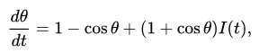
A phenomenological model of seizure transitions
Models in epilepsy:
Wendling model [1], Benjamin model [2], epileptor [3], …
We will consider the “theta model” [4], a phase oscillator model:
[1] Wendling, F., et al. "Epileptic fast activity can be explained by a model of impaired GABAergic dendritic inhibition." European Journal of Neuroscience 15.9 (2002): 1499-1508.
[2] Benjamin, Oscar, et al. "A phenomenological model of seizure initiation suggests network structure may explain seizure frequency in idiopathic generalised epilepsy." The Journal of Mathematical Neuroscience 2.1 (2012): 1.
[3] Jirsa, Viktor K., et al. "On the nature of seizure dynamics." Brain 137.8 (2014): 2210-2230.
[4] Lopes, Marinho A., et al. "An optimal strategy for epilepsy surgery: Disruption of the rich-club?." PLoS computational biology 13.8 (2017); http://www.scholarpedia.org/article/Ermentrout-Kopell_canonical_model ; https://en.wikipedia.org/wiki/Theta_model

Slide 10
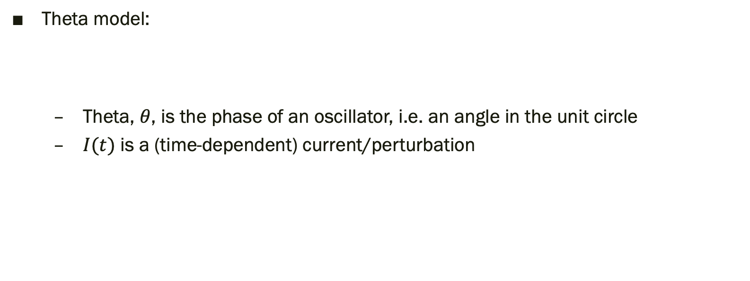
What does it mean?
π/2
π
0, 2π, 2π k
Theta model:
Theta, $θ$, is the phase of an oscillator, i.e. an angle in the unit circle
$I(t)$ is a (time-dependent) current/perturbation
3π/2

Slide 11
Why use the theta model?
The model describes two states: a stable state (normal) and oscillations (seizures)
It is a minimal/ canonical model.
It is NOT sufficiently complex to describe different normal states, or pre-ictal states, seizure evolution, etc.
However, it may be sufficient to understand why some brain networks are prone to generate seizures.

Slide 12
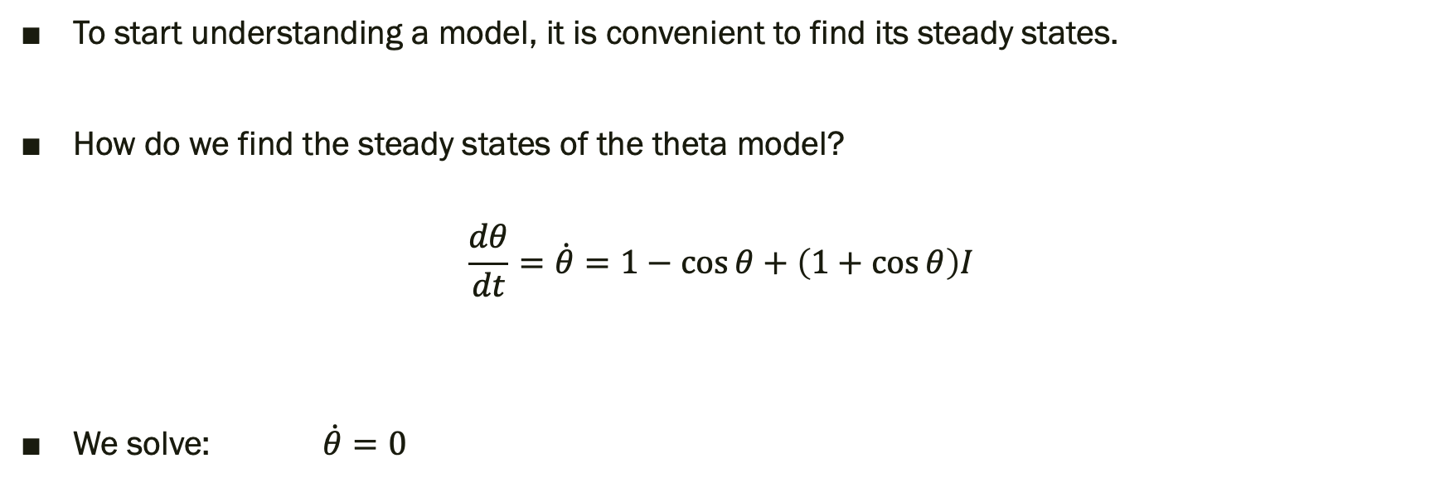
Let’s play with the model!
To start understanding a model, it is convenient to find its steady states.
How do we find the steady states of the theta model?
$$\frac{dθ}{dt}=\dot{θ}=1−\cos{θ}+\left(1+\cos{θ}\right)I$$
We solve: $\dot{θ}=0$

Slide 13
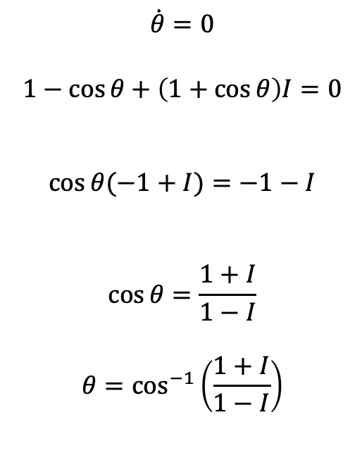
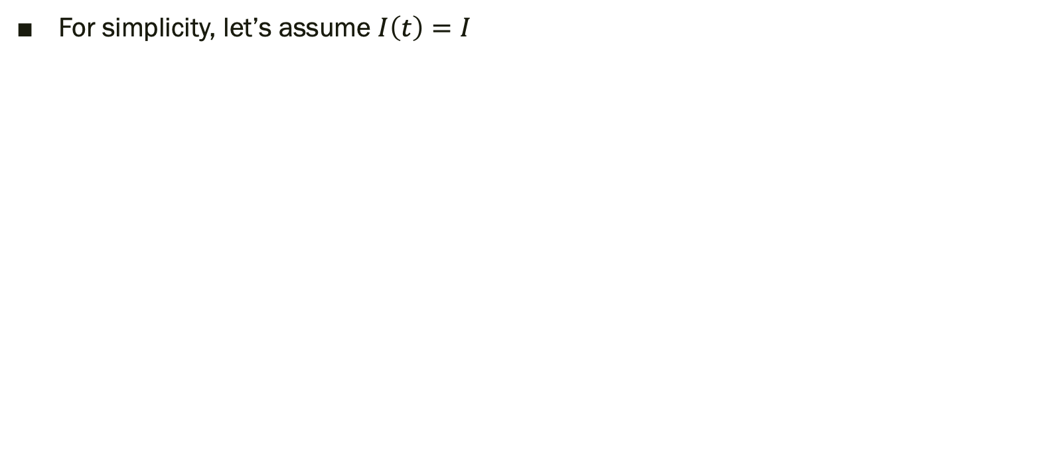
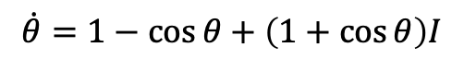
Theta model: steady states
For simplicity, let’s assume $I\left(t\right)=I$
$$\dot{θ}=1−\cos{θ}+\left(1+\cos{θ}\right)I$$
$$\dot{θ}=0$$
$$1−\cos{θ}+\left(1+\cos{θ}\right)I=0$$
$$\cos{θ(−1+I)}=−1−I$$
$$\cos{θ}=\frac{1+I}{1−I}$$
$$θ=\cos^{−1}\left(\frac{1+I}{1−I}\right)$$
What are the consequences of this result?

Slide 14
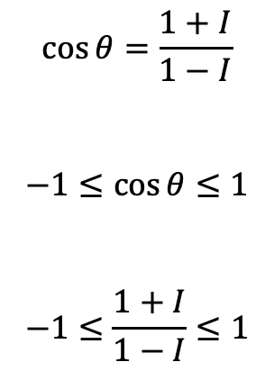
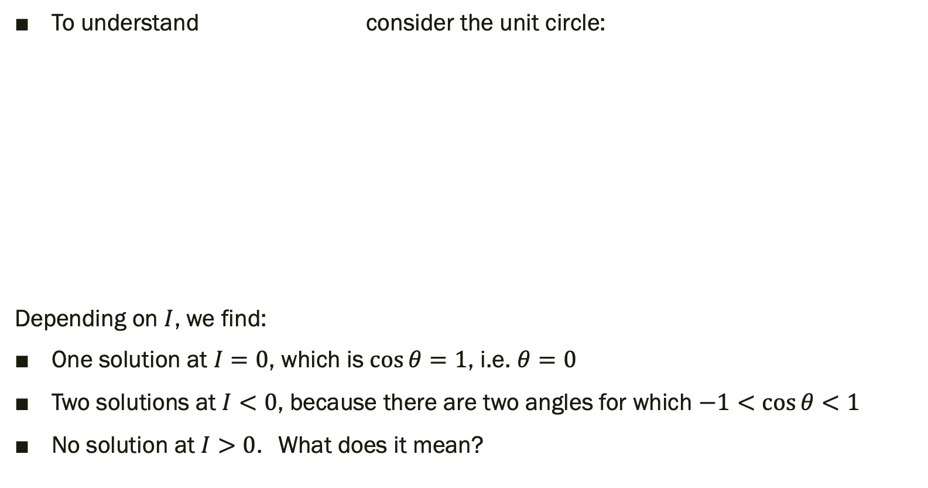
Theta model: steady states
$$\cos{θ}=\frac{1+I}{1−I}$$
$$−1≤cos{θ≤1}$$
$$−1≤\frac{1+I}{1−I}≤1$$
To understand consider the unit circle:
Depending on $I$, we find:
One solution at $I=0$, which is $\cos{θ}=1$, i.e. $θ=0$
Two solutions at $I<0$, because there are two angles for which $−1<cos{θ<1}$
No solution at $I>0$. What does it mean?

Slide 15
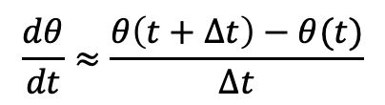
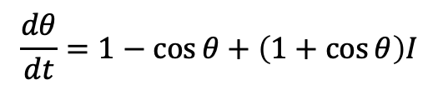
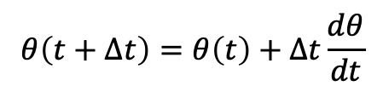
Let’s look at the dynamics
To simulate the theta model we can use Euler’s method:
$$\frac{dθ}{dt}≈\frac{θ\left(t+Δt\right)−θ(t)}{Δt}$$
$$θ\left(t+Δt\right)=θ\left(t\right)+Δt\frac{dθ}{dt}$$
$$\frac{dθ}{dt}=1−\cos{θ}+\left(1+\cos{θ}\right)I$$
$$θ\left(t+Δt\right)=θ\left(t\right)+Δt\left[1−\cos{θ}+\left(1+\cos{θ}\right)I\right]$$
This will be one of your tasks in the practical session

Slide 16
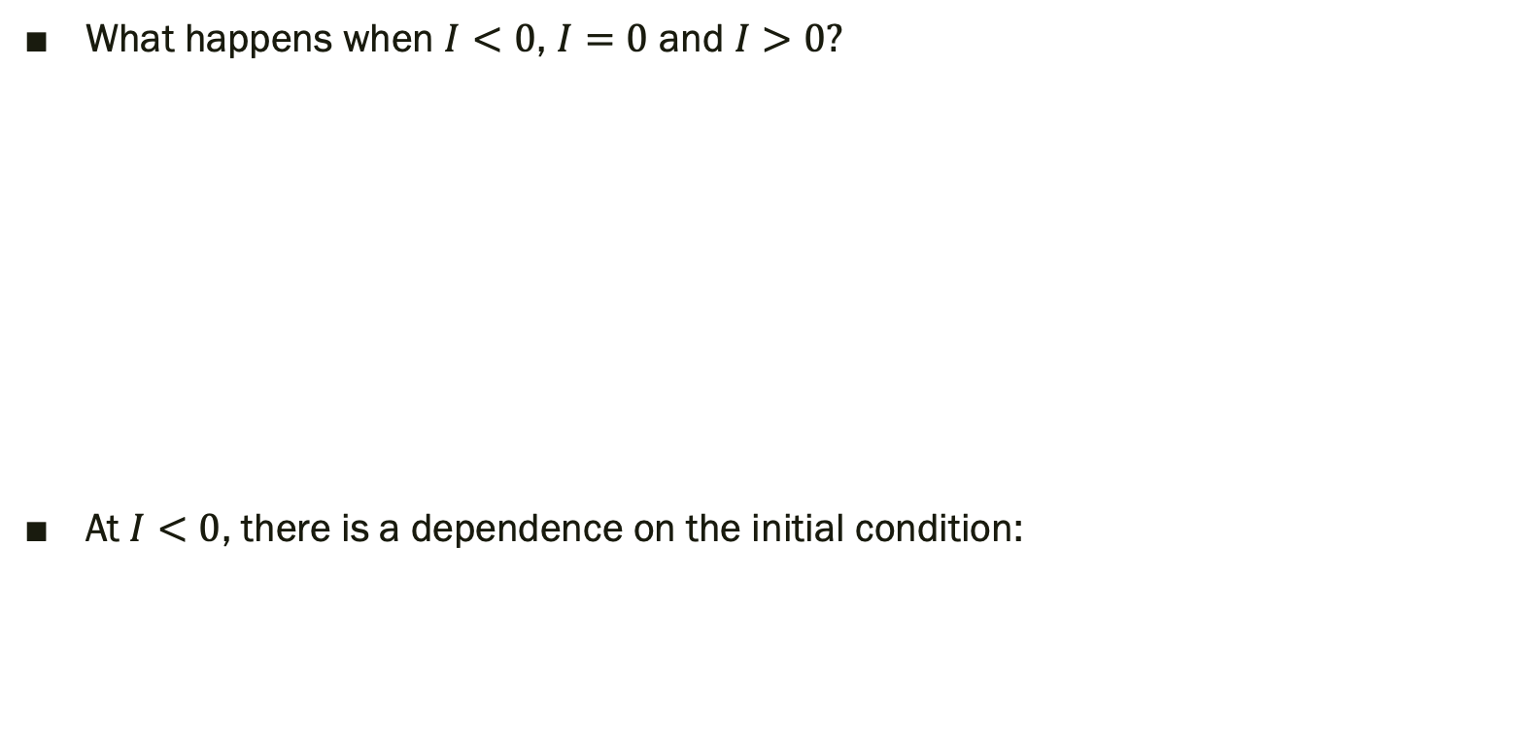
Dynamics of one theta oscillator
What happens when $I<0$, $I=0$ and $I>0?$
At $I<0$, there is a dependence on the initial condition:
You will explore this in the practical session

Slide 17
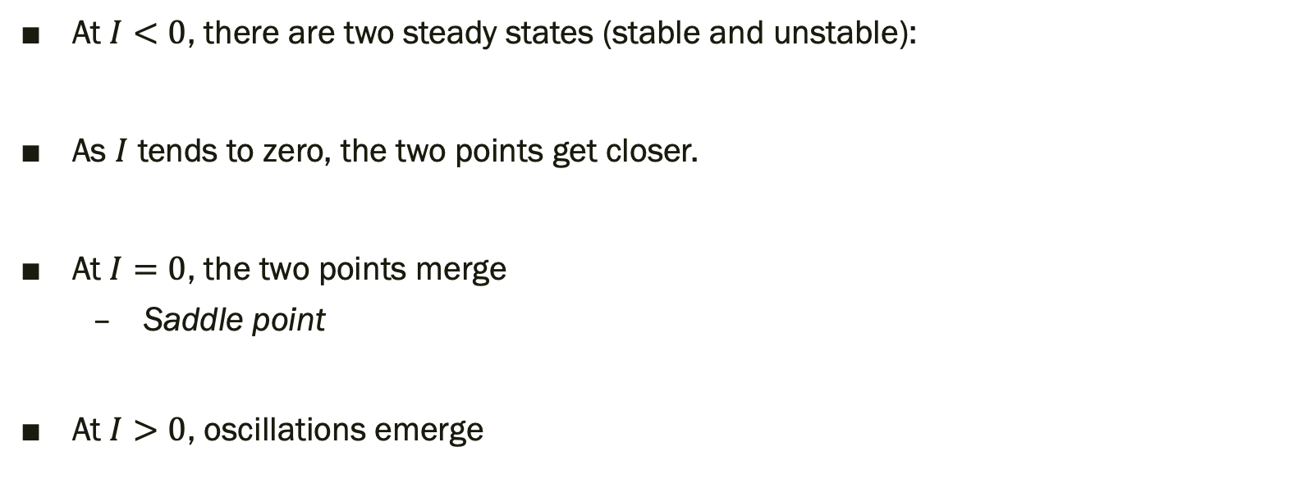
Theta model: steady states
At $I<0$, there are two steady states (stable and unstable):
As $I$ tends to zero, the two points get closer.
At $I=0$, the two points merge
Saddle point
At $I>0$, oscillations emerge

Slide 18
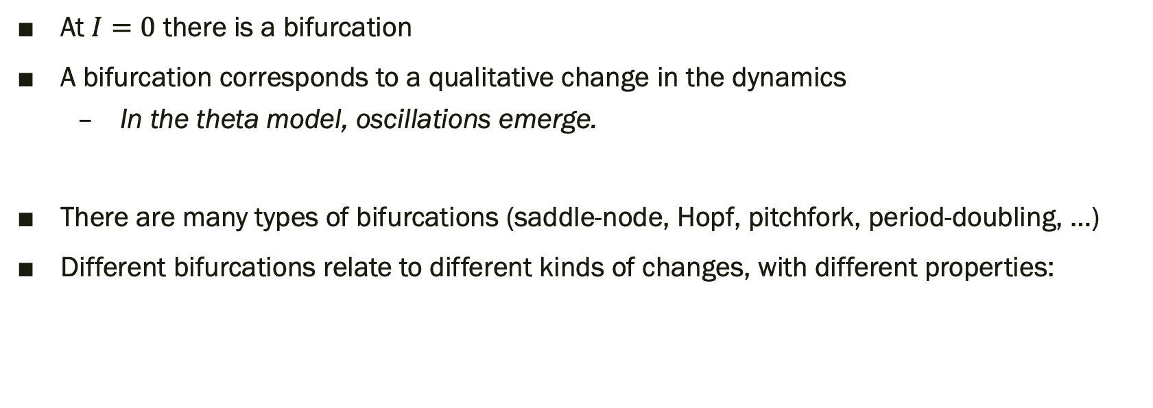
The theta model undergoes a bifurcation
At $I=0$ there is a bifurcation
A bifurcation corresponds to a qualitative change in the dynamics
In the theta model, oscillations emerge.
There are many types of bifurcations (saddle-node, Hopf, pitchfork, period-doubling, …)
Different bifurcations relate to different kinds of changes, with different properties:
Jirsa, Viktor K., et al. "On the nature of seizure dynamics." Brain 137.8 (2014): 2210-2230.

Slide 19
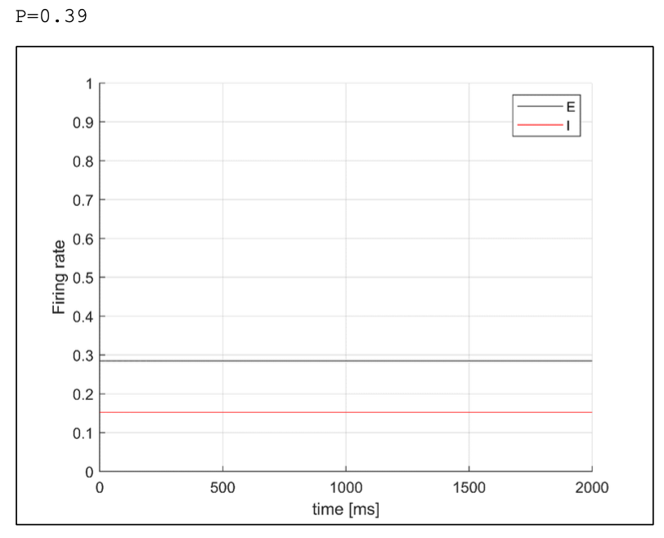
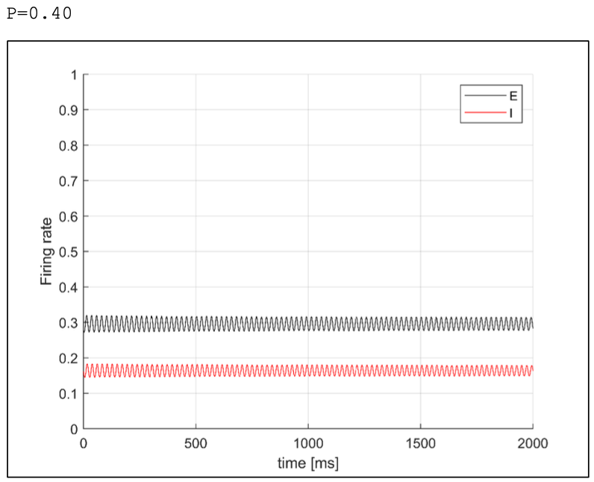
You have already met a Hopf bifurcation
If you did the previous practical session, you may remember:

Slide 20
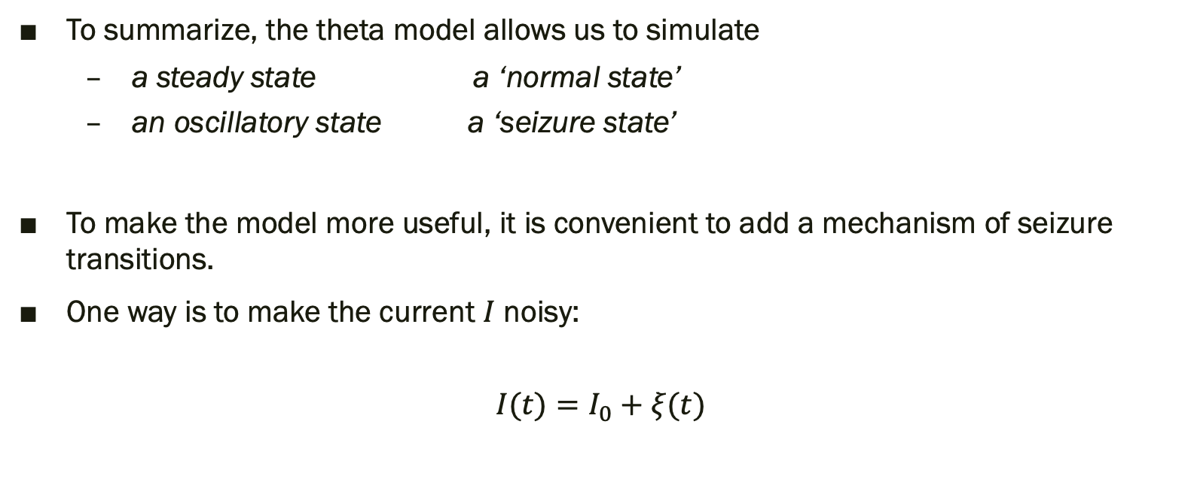
Back to our phase oscillator
To summarize, the theta model allows us to simulate
a steady state a ‘normal state’
an oscillatory state a ‘seizure state’
To make the model more useful, it is convenient to add a mechanism of seizure transitions.
One way is to make the current $I$ noisy:
$$I(t)=I_{0}+ξ(t)$$

Slide 21
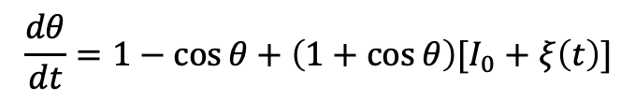
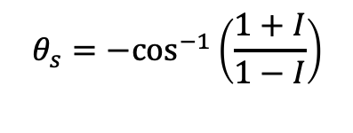
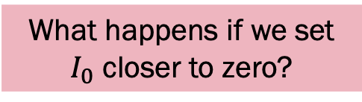
A noisy phase oscillator
$$\frac{dθ}{dt}=1−\cos{θ}+\left(1+\cos{θ}\right)[I_{0}+ξ\left(t\right)]$$
What are the consequences of a noisy current?
In the steady state:
interictal spikes
$$θ_{s}={−cos}^{−1}\left(\frac{1+I}{1−I}\right)$$
What’s the origin of these spikes?
What happens if we set $I_{0}$ closer to zero?
You will explore this in more detail in the practical session

Slide 22
A noisy phase oscillator
The consequences on the oscillations:

Slide 23
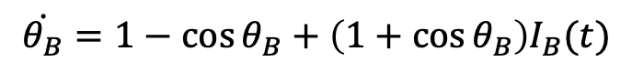
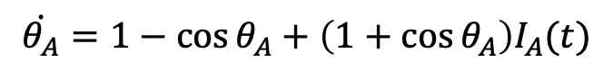
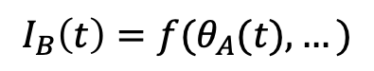
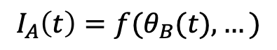
What can we do with our oscillator model?
We can use it to represent the brain activity at one brain region
Since we are interested in brain networks, we need to consider multiple brain regions and consequently multiple oscillators.
If we consider two regions (A and B), we have two ODEs:
What do we need so that the two oscillators interact with each other?
$$\dot{θ_{A}}=1−\cos{θ_{A}}+\left(1+\cos{θ_{A}}\right)I_{A}(t)$$
$$\dot{θ_{B}}=1−\cos{θ_{B}}+\left(1+\cos{θ_{B}}\right)I_{B}(t)$$
$$I_{A}\left(t\right)=f(θ_{B}(t),…)$$
$$I_{B}\left(t\right)=f(θ_{A}(t),…)$$

Slide 24
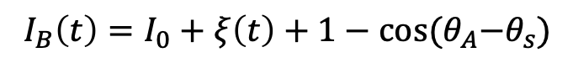
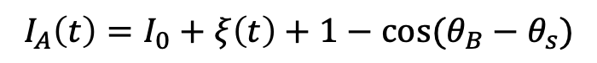
Two interacting oscillators
How shall we make the two oscillators to interact?
A simple way is to assume one can ‘excite’ the other with its output:
Therefore, we get the two following SDEs:
$$I_{A}\left(t\right)=I_{0}+ξ\left(t\right)+1−\cos{(θ_{B}−θ_{s})}$$
$$I_{B}\left(t\right)=I_{0}+ξ\left(t\right)+1−\cos{{(θ}_{A}−θ_{s})}$$
$\dot{θ_{A}}=1−\cos{θ_{A}}+\left(1+\cos{θ_{A}}\right)[I_{0}+ξ\left(t\right)+1−\cos{(θ_{B}−θ_{s})}$]
$$\dot{θ_{B}}=1−\cos{θ_{B}}+\left(1+\cos{θ_{B}}\right)[I_{0}+ξ\left(t\right)+1−\cos{{(θ}_{A}−θ_{s})}]$$

Slide 25
Two interacting oscillators
Their dynamics can be correlated:
… or not:
What defines whether they are correlated?

Slide 26

A network of oscillators
The brain has more than two regions…
N interacting regions can be represented by N theta oscillators:
$$\dot{θ_{1}}=1−\cos{θ_{1}}+\left(1+\cos{θ_{1}}\right)I_{1}\left(t\right), where I_{1}(t)=f(θ_{2},θ_{3},…,θ_{N})$$
$$\dot{θ_{2}}=1−\cos{θ_{2}}+\left(1+\cos{θ_{2}}\right)I_{2}\left(t\right), where I_{2}(t)=f(θ_{1},θ_{3},…,θ_{N})$$
$$…$$
$$\dot{θ_{N}}=1−\cos{θ_{N}}+\left(1+\cos{θ_{N}}\right)I_{N}\left(t\right), where I_{N}(t)=f(θ_{1},θ_{2},…,θ_{N−1})$$

Slide 27
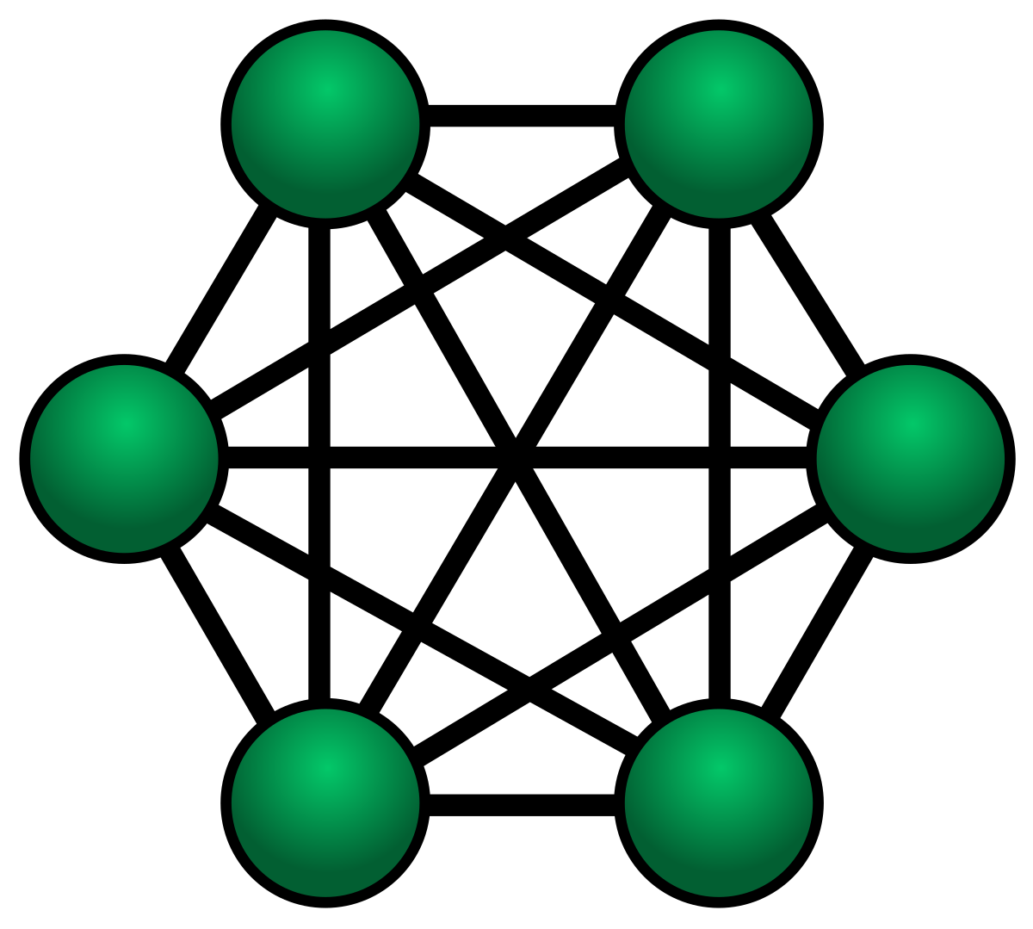
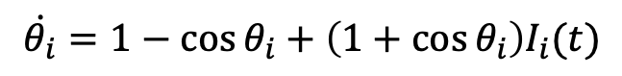
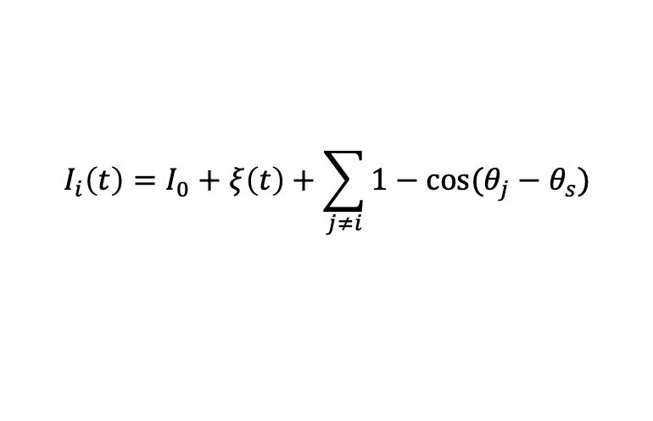
A network of oscillators
If all oscillators interact with all other oscillators, then:
This is a special case when the underlying network is fully connected:
$$\dot{θ_{i}}=1−\cos{θ_{i}}+\left(1+\cos{θ_{i}}\right)I_{i}(t)$$
$$I_{i}\left(t\right)=I_{0}+ξ\left(t\right)+\sum_{j≠i}{1−\cos{(θ_{j}−θ_{s})}}$$
A network is a set of nodes connected by links
Network = graph
Node=vertex
Connection/link = edge

Slide 28
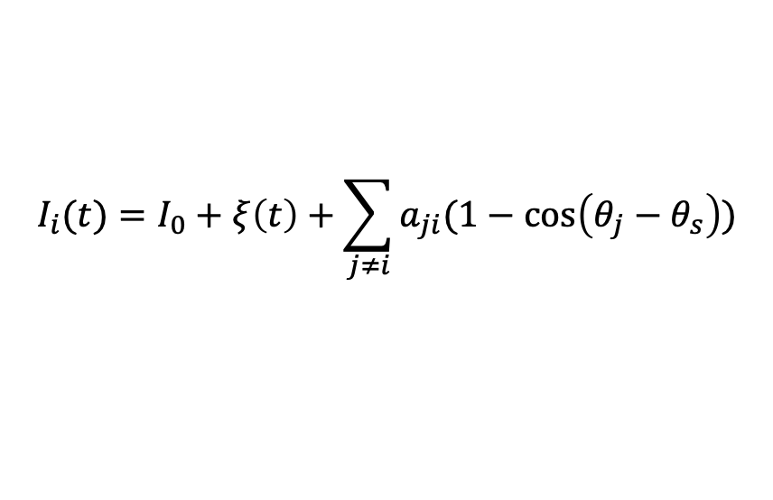
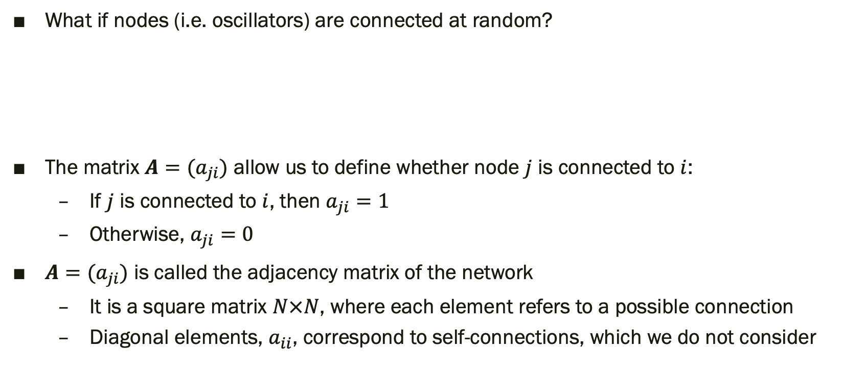

A network of oscillators
1
2
6
3
5
4
What if nodes (i.e. oscillators) are connected at random?
The matrix $A=(a_{ji})$ allow us to define whether node $j$ is connected to $i$:
If $j$ is connected to $i$, then $a_{ji}=1$
Otherwise, $a_{ji}=0$
$A=(a_{ji})$ is called the adjacency matrix of the network
It is a square matrix $N×N$, where each element refers to a possible connection
Diagonal elements, $a_{ii}$, correspond to self-connections, which we do not consider
0 0 0 1 1 0
0 0 0 0 0 1
0 0 0 0 0 1
1 0 0 0 1 0
1 0 0 1 0 0
0 1 1 0 0 0
$$I_{i}(t)=I_{0}+ξ\left(t\right)+\sum_{j≠i}{a_{ji}(1−\cos\left(θ_{j}−θ_{s}\right)})$$
$$A =$$

Slide 29
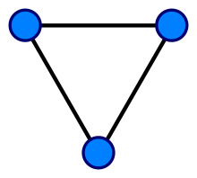
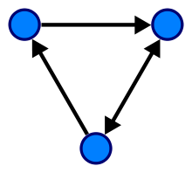
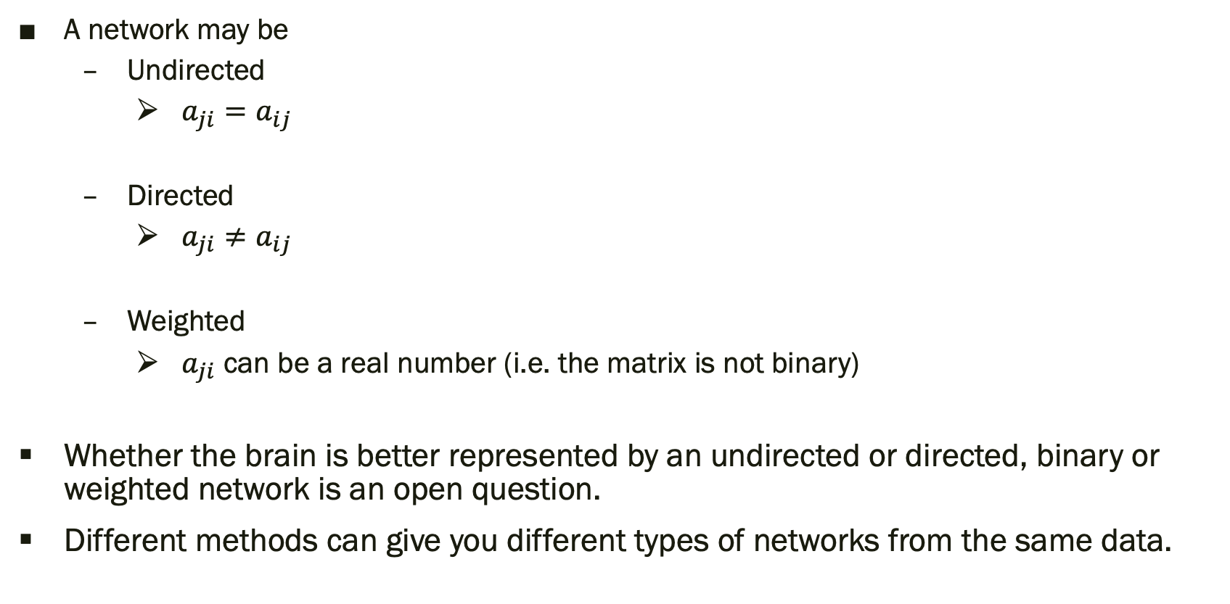
Side note: Types of networks
A network may be
Undirected
$a_{ji}=a_{ij}$
Directed
$a_{ji}≠a_{ij}$
Weighted
$a_{ji}$ can be a real number (i.e. the matrix is not binary)
Whether the brain is better represented by an undirected or directed, binary or weighted network is an open question.
Different methods can give you different types of networks from the same data.

Slide 30
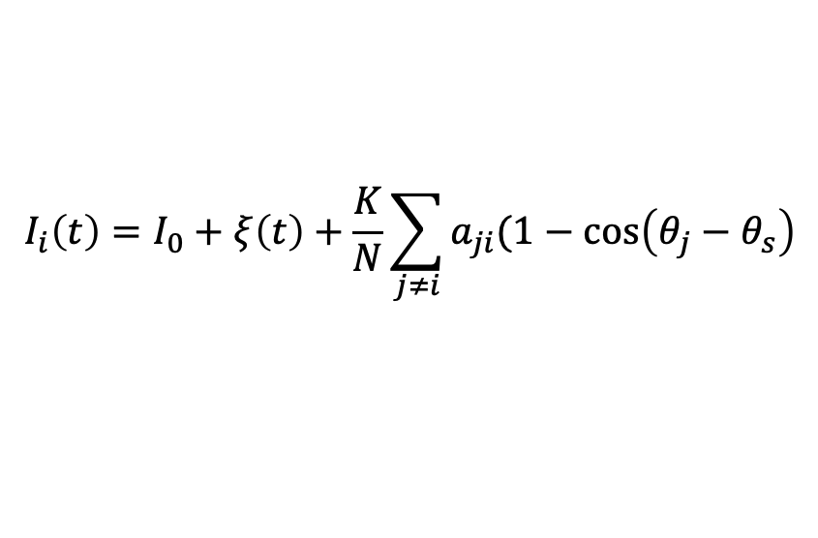
Back to a network of oscillators
Since different networks may have different characteristics, it is convenient to add an additional parameter:
What kind of dynamics can we observe in a random network?
$$I_{i}\left(t\right)=I_{0}+ξ\left(t\right)+\frac{K}{N}\sum_{j≠i}{a_{ji}(1−\cos\left(θ_{j}−θ_{s}\right)}$$
1
2
6
3
5
4
You will explore this in more detail in the practical session
(with some small differences)

Slide 31
What is this useful for?
Such framework allows us to test a number of hypothesis:
The structure of a brain network may define its propensity to generate seizures
Diagnosis of epilepsy:
brain networks from healthy people may spike more than brain networks from people with epilepsy in model simulations
Diagnosis of epilepsy type, generalised vs focal:
brain networks from people with generalised epilepsy may have more widespread seizure-like activity in model simulations
Epilepsy treatments, such as brain surgery:
Node removal may represent resective surgery, and simulations of different removals allows us test different possible surgeries

Slide 32
Applications of the framework in the literature
Diagnosis of epilepsy:
Lopes, M.A., et al., (2020). https://www.medrxiv.org/content/10.1101/2020.05.18.20102681v1
Diagnosis of epilepsy type:
Lopes, M. A., et al. (2019). Sci Rep, 9(1), 1-10. https://www.nature.com/articles/s41598-019-46633-7
Epilepsy surgery:
Lopes, M.A., et al. (2017). PLoS CB, 13(8). https://doi.org/10.1371/journal.pcbi.1005637 Lopes, M.A., et al. (2018). Front Neurol, 9, 98. https://www.frontiersin.org/articles/10.3389/fneur.2018.00098/full Junges, L., et al. (2019). Sci Rep, 9(1), 1-12. https://www.nature.com/articles/s41598-019-43871-7 Laiou, P., et al. (2019). Front Neurol, 10, 1045. https://www.frontiersin.org/articles/10.3389/fneur.2019.01045/full Lopes, M. A., et al. (2020). Clin Neurophysiol, 131(1), 225-234. https://doi.org/10.1016/j.clinph.2019.10.027 Lopes, M. A., et al. (2019). Front Comput Neurosci, 13, 25. https://doi.org/10.3389/fncom.2019.00025 Lopes, M. A., et al. (2020). Front Neurol, 11, 74. https://www.frontiersin.org/articles/10.3389/fneur.2020.00074/full
Animal models of epilepsy:
Słowiński, P., et al. (2019). eNeuro, 6(4). https://www.eneuro.org/content/6/4/ENEURO.0059-19.2019

Slide 33
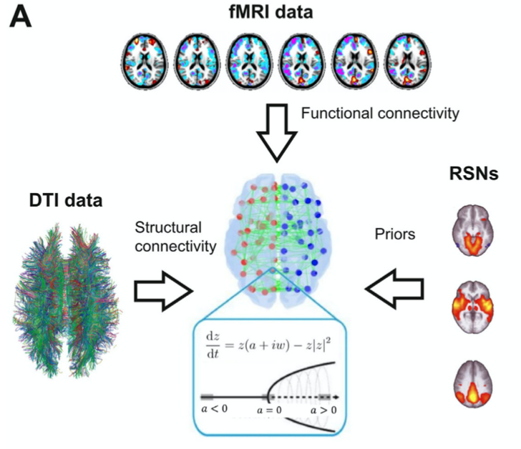
Is this only useful for epilepsy?
No!
It may help understand the differences and transitions between wakefulness and sleep states:
Ipiña, I.P., et al. (2020). NeuroImage, 116833.
It may help understand how functional networks emerge from structural networks; their relation; etc.
To study how neuronal dynamics can be robust to changes in white matter connectivity (in aging, development and diseases)
Abeysuriya, R.G., et al. (2018). PLoS CB, 14(2), e1006007.
To understand other neurological diseases and treatments.

Slide 34
Practical session: Modelling the emergence of seizures in networks
The practical session is divided in three parts:
Simulate a deterministic phase oscillator (15 min + 5 min for solutions)
Simulate a stochastic phase oscillator (10 min + 5 min for solutions)
Simulate a network of interacting phase oscillators (15 min + 5 min for solutions)
Download and extract the git repository www.github.com/lukewtait/intro_to_modelling/
In this folder, open the subfolder practical2 and open the document Worksheet2.pdf.
This directory also contains some Matlab codes that you will need to use, so make sure when you open Matlab you change to this directory.
There are solutions in the subdirectory practical2/solutions. Try to solve the problems yourself or ask a tutor first, but if you get stuck you can use these solutions to help you.
You will be assigned to a breakout room, where you can ask questions to other people in the room
There will be one tutor per breakout room. Solutions will be discussed in the main room.

